Slide 1

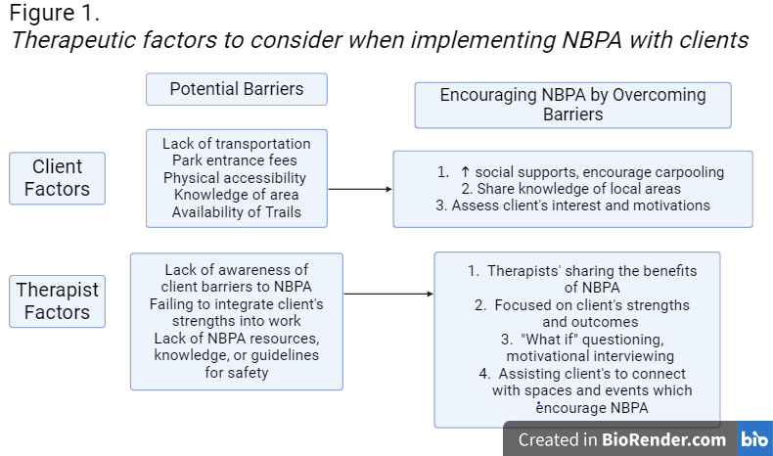
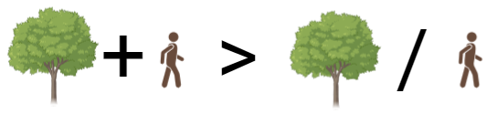

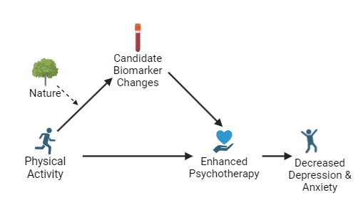
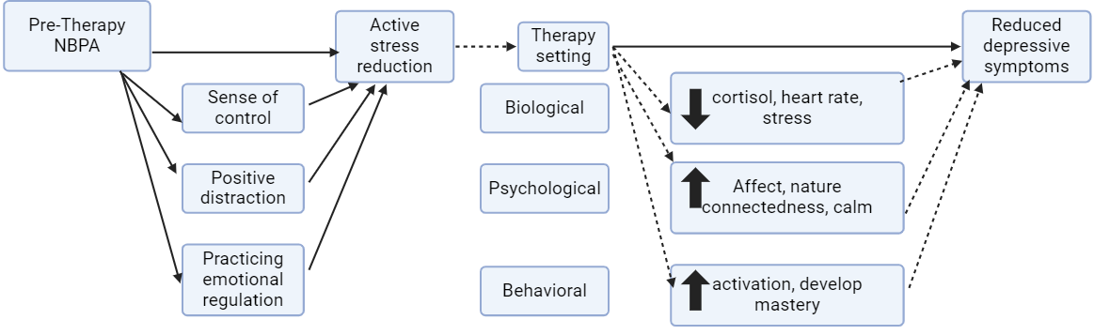

Call to Action: Using Nature-Based Physical Activity to Enhance Therapy Outcomes in Major Depressive Disorder
Corrine M. Schwarting¹, PhD Candidate, Shania J.E., Kelly², MS, Jacob D. Meyer², PhD, FACSM, and Nathaniel Wade¹, PhD
¹Department of Psychology, Iowa State University, Ames, IA
²Department of Kinesiology, University of Wisconsin-Madison, Madison, WI
Important Definitions
Rationale and Purpose
Application
Nature is any outdoor area, forests, 'green spaces' (e.g., city parks), lakes, ponds, and rivers.
  Clients have different availability and access to nature based on their place of residence, transportation, and work duties.
Nature-based physical activity (NBPA) is any movement done outdoors. It measured and validated by adapting the International Physical Activity Questionnaire (I-PAQ)⁶
Major Depressive Disorder (MDD) is a clinical diagnosis of 5 or more symptoms related to fatigue, difficulties concentrating, irritability, appetite or sleep changes, or thoughts of suicide that persist for at least two weeks.
  MDD is associated with large economic burdens, challenges in daily functioning, and reduced quality of life for individuals ¹⁴
Concurrent nature exposure and psychotherapy improve mental health but face privacy concerns, limiting their implementation⁴
Nature exposure (NE) and physical activity (PA) each lower cortisol, blood pressure, and increase biomarkers like BDNF, benefiting those with anxiety, depression, and fatigue. ^{1,2, 8, 10}
Combining NE and PA (NBPA) may enhance mental health benefits and reduce privacy issues seen in nature-based psychotherapy.
Performing NBPA before therapy could improve psychotherapy outcomes, particularly for clients with MDD and anxiety.
Due to the additive effects of NBPA and therapy, our aim is to provide researchers and clinicians evidence to consider implementing NBPA prior to therapy when working with clients with Major Depressive Disorder.
Resources:
Proposed Theory
Proposed Mechanism
Psychological Priming Effects
Mental and sensory stimulation
Attention / information intake
Conscious processing
Our review is rooted in Stress Reduction Theory (SRT) ¹⁵, which suggests nature exposure triggers physiological changes to reduce stress and promote our well-being.
4
Figure 3. Mechanistic pathway showcasing the impact of physical activity on mental wellbeing
Physical activity has been shown to impact candidate biomarkers, such as cortisol ¹¹ and brain-derived neurotrophic factor ⁵, that may lead to enhanced psychotherapy outcomes^{8,10}.
Nature exposure may act as a moderator, enhancing BDNF and cortisol changes, allowing for even greater effects on mental wellbeing during psychotherapy^{7,13}
These biological changes may lead to more effective subsequent psychotherapy, potentially leading to better mental health outcomes over time¹²
Figure 2. Psychological priming effects of NBPA, rooted in Stress Reduction Theory (SRT) ¹⁵
Key References
Berman, M. G., Kross, E., Krpan, K. M., Askren, M. K., Burson, A., Deldin, P. J., Kaplan, S., Sherdell, L., Gotlib, I. H., & Jonides, J. (2012). Interacting with nature improves cognition and affect for individuals with depression. Journal of Affective Disorders, 140(3), 300–305. https://doi.org/10.1016/j.jad.2012.03.012
Christiana, R. W., Besenyi, G. M., Gustat, J., Horton, T. H., Penbrooke, T. L., & Schultz, C. L. (n.d.). 1A Scoping Review of the Health Benefits of Nature-Based Physical Activity. Journal of Healthy Eating and Active Living, 1(3), 154–172.
Cuijpers, P. (2018). The Challenges of Improving Treatments for Depression. JAMA, 320(24), 2529–2530. https://doi.org/10.1001/jama.2018.17824
DeAngelis, T. (2013). Therapy and exercise needn’t be mutually exclusive. Here’s how to incorporate the outdoors, walking and other exercise into therapy in a way that’s good for clients and for you. American Psychological Association 44(8), 56.
Huang, T., Larsen, K. T., Ried-Larsen, M., Møller, N. C., & Andersen, L. b. (2014). The effects of physical activity and exercise on brain-derived neurotrophic factor in healthy humans: A review. Scandinavian Journal of Medicine & Science in Sports, 24(1), 1–10. https://doi.org/10.1111/sms.12069
Jenkins, M., Lee, C., Houge Mackenzie, S., Anne Hargreaves, E., Hodge, K., & Calverley, J. (2022). Nature-Based Physical Activity and Hedonic and Eudaimonic Wellbeing: The Mediating Roles of Motivational Quality and Nature Relatedness. Frontiers in Psychology, 13. https://doi.org/10.3389/fpsyg.2022.783840
Wong, V. W.-H., Ho, F. Y.-Y., Shi, N.-K., Sarris, J., Chung, K.-F., & Yeung, W.-F. (2021). Lifestyle medicine for depression: A meta-analysis of randomized controlled trials. Journal of Affective Disorders, 284, 203–216. https://doi.org/10.1016/j.jad.2021.02.012
Jones, R., Tarter, R., & Ross, A. M. (2021). Greenspace Interventions, Stress and Cortisol: A Scoping Review. International Journal of Environmental Research and Public Health, 18(6), Article 6. https://doi.org/10.3390/ijerph18062802
Kunugi, H., Hori, H., Adachi, N., & Numakawa, T. (2010). Interface between hypothalamic-pituitary-adrenal axis and brain-derived neurotrophic factor in depression. Psychiatry and Clinical Neurosciences, 64(5), 447–459. https://doi.org/10.1111/j.1440-1819.2010.02135.x
Maund, P., Irvine, K., Reeves, J., Strong, E., Cromie, R., Dallimer, M., & Davies, Z. (2019). Wetlands for Wellbeing: Piloting a Nature-Based Health Intervention for the Management of Anxiety and Depression. International Journal of Environmental Research and Public Health, 16(22). https://doi.org/10.3390/ijerph16224413
Meyer, J. D., Koltyn, K. F., Stegner, A. J., Kim, J.-S., & Cook, D. B. (2016). Relationships between serum BDNF and the antidepressant effect of acute exercise in depressed women. Psychoneuroendocrinology, 74, 286–294. https://doi.org/10.1016/j.psyneuen.2016.09.022
Meyer, J.D., Perkins, S.L., Brower, C.S., Lansing, J.L., Slocum, J.A., Thomas, E.B., Murray, T.A., Lee, D.C., Wade, N.G. (2022). Feasibility of an Exercise and CBT Intervention for Treatment of Depression: A Pilot Randomized Controlled Trial. Frontiers in Psychiatry, 13. https://doi.org/10.3389/fpsyt.2022.799600
Moyers, S. A., & Hagger, M. S. (2023). Physical activity and cortisol regulation: A meta-analysis. Biological Psychology, 179, 108548. https://doi.org/10.1016/j.biopsycho.2023.108548
Stott, D., Forde, D., Sharma, C., Deutsch, J. M., Bruneau, M., Nasser, J. A., Vitolins, M. Z., & Milliron, B.-J. (2024). Interactions with Nature, Good for the Mind and Body: A Narrative Review. International Journal of Environmental Research and Public Health, 21(3), Article 3. https://doi.org/10.3390/ijerph21030329
Ulrich, R.S., Simons, R.F., Losito, B.D., Fiorito, E., Miles, M.A., & Zelson, M. (1991). Stress recovery during exposure to natural and urban environments. Journal of Environmental Psychology, 11, 201-230. https://doi.org/10.1016/S0272-4944(05)80184-7
The current project is supported by the National Institute of Mental Health (NIMH) R61: 1R61MH129407.
Questions?
Please email Corrine Schwarting at corrines@iastate.edu

