Slide 1


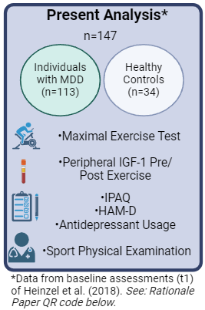


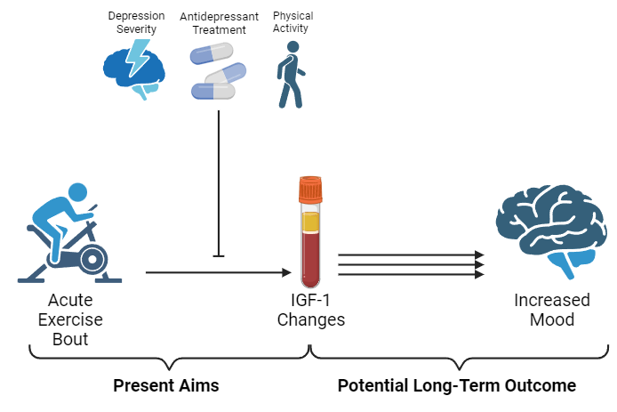
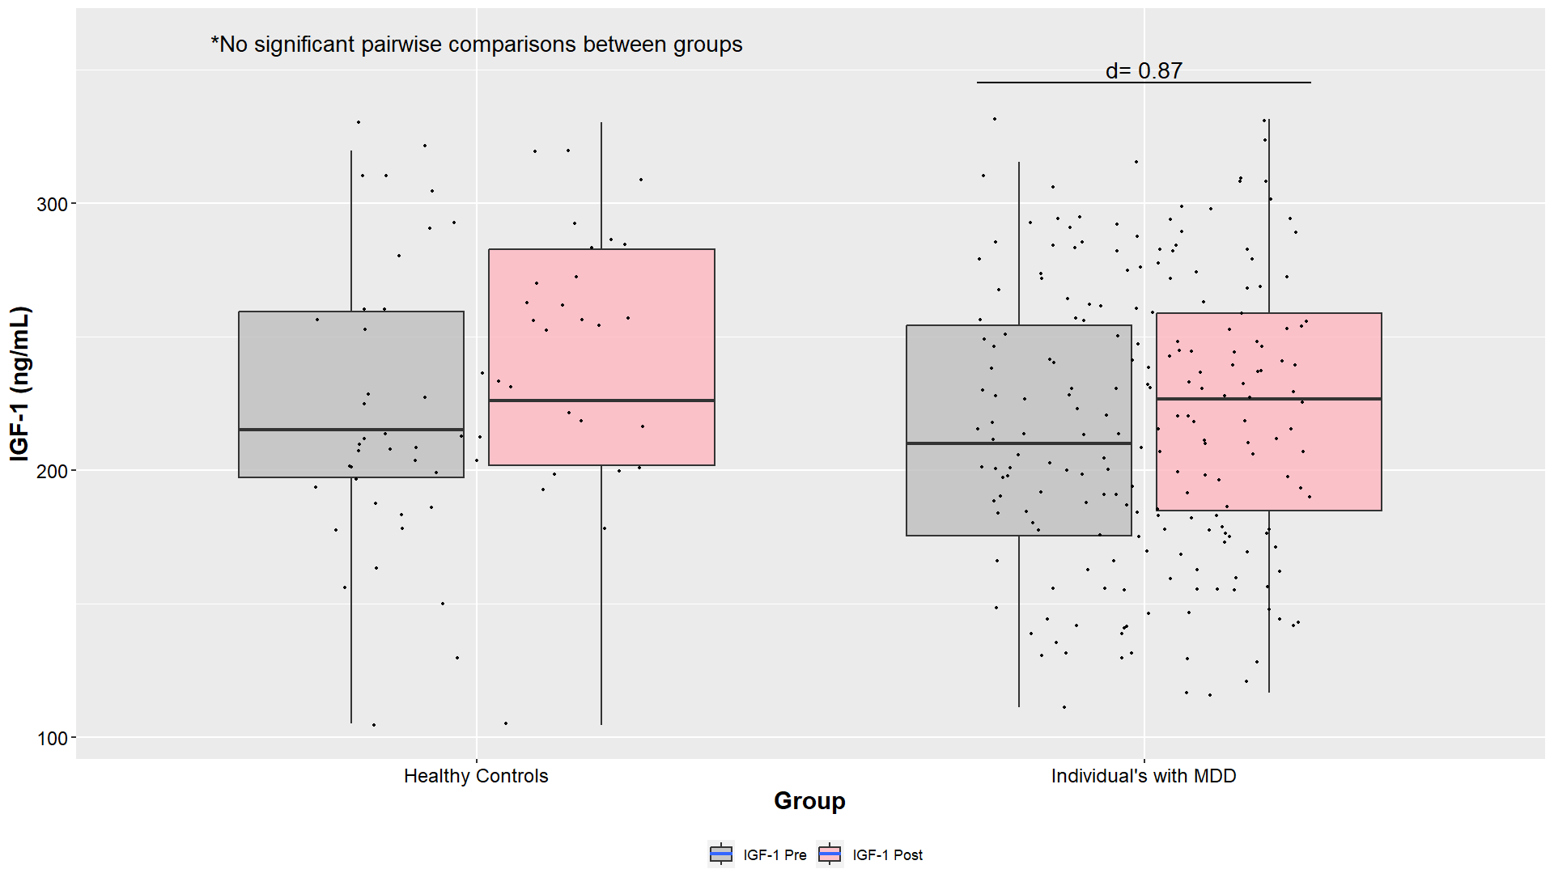
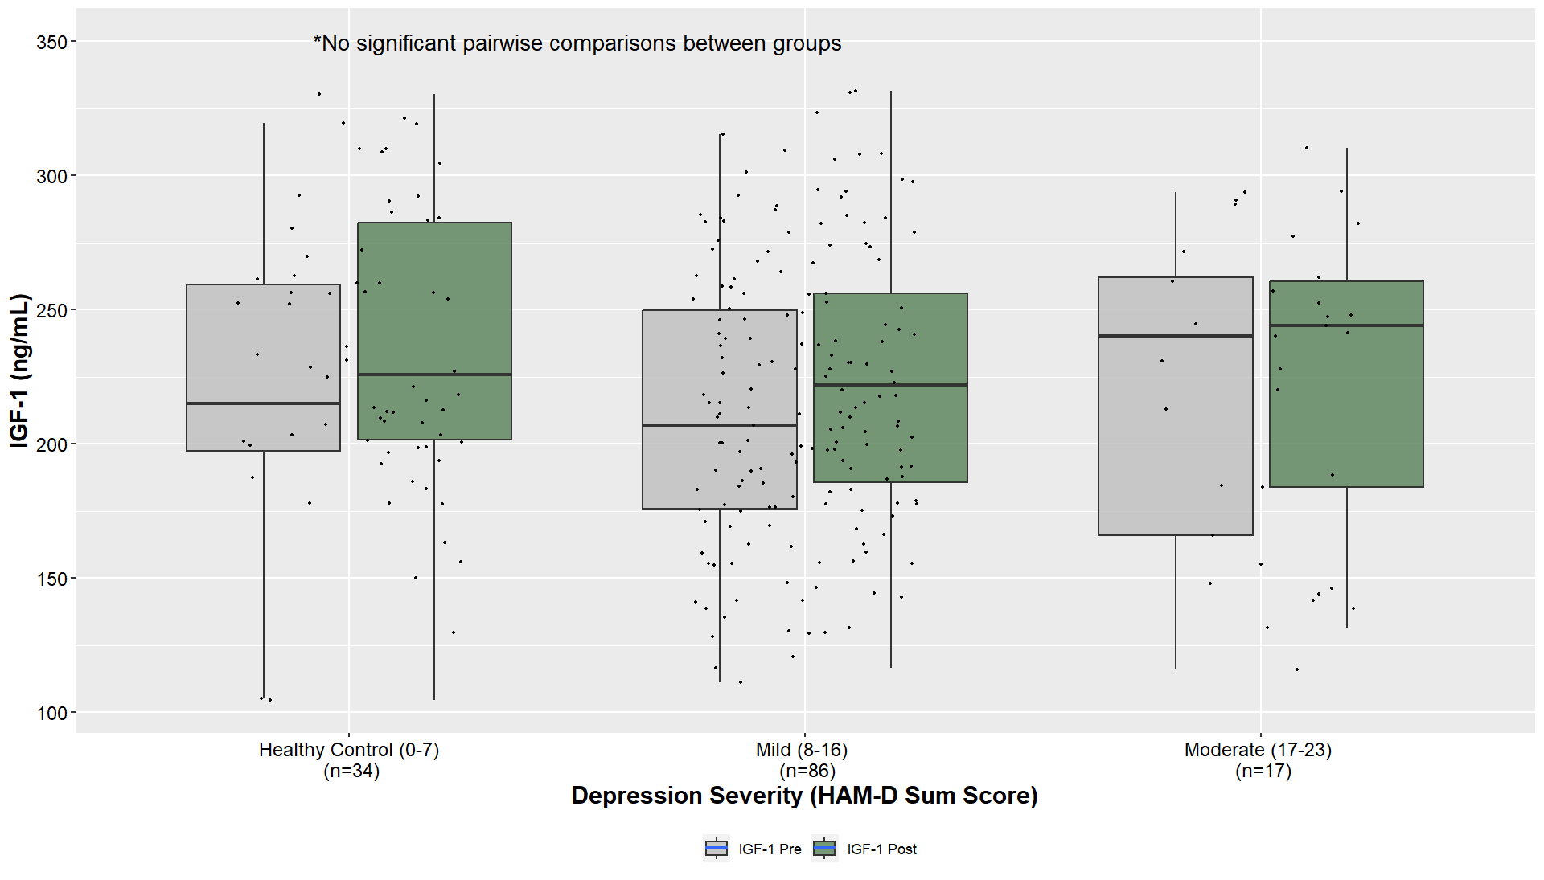

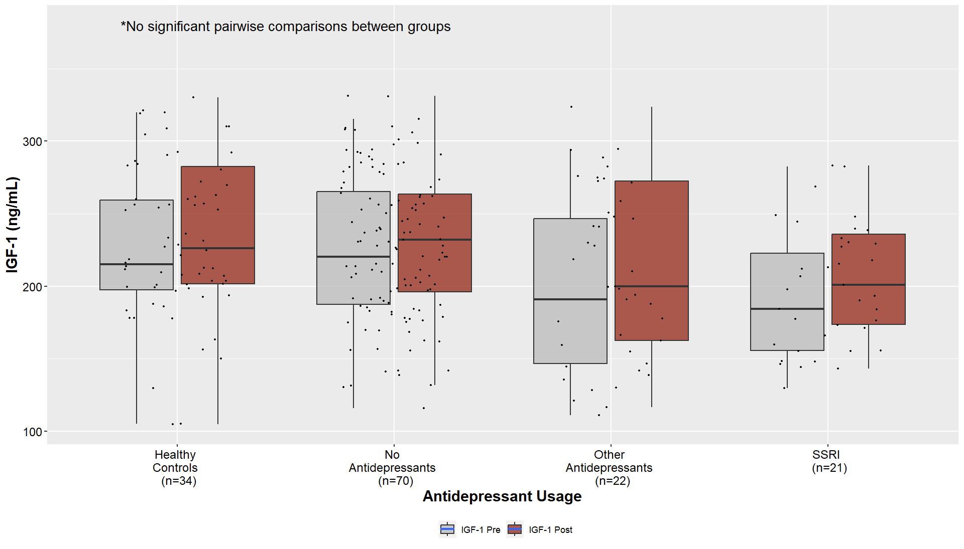
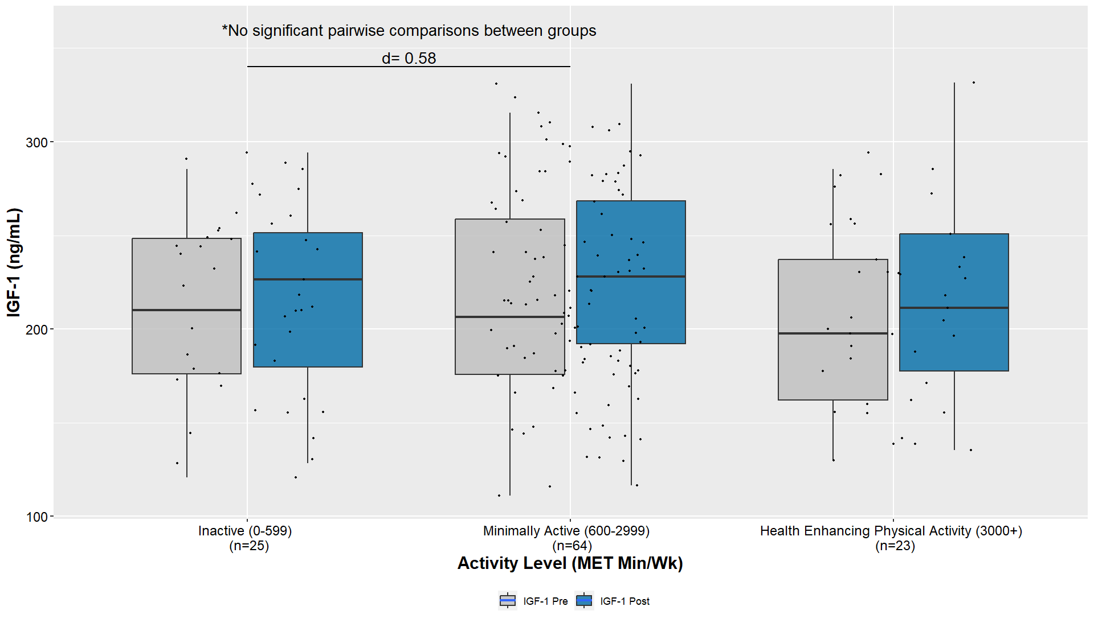






Influences of an Acute Exercise Bout on Insulin-Like Growth Factor-1 in Adults with Major Depressive Disorder
Shania J.E., Kelly¹, Christiane Stielow², Stephan Heinzel³, PhD, Andreas Heissel², PhD, and Jacob D. Meyer¹, PhD, FACSM
¹Department of Kinesiology, Iowa State University, Ames, IA
²Department of Exercise and Health Sciences, University of Potsdam, Potsdam, Germany
³Department of Educational Sciences and Psychology, Technical University of Dortmund, Germany
Rationale
Key Findings
Conclusions
Insulin-like growth factor-1 (IGF-1) has important neurological functions that may be dysregulated in major depressive disorder (MDD)¹.
Acute exercise can temporarily raise IGF-1 levels in healthy individuals³.
Exercise-induced IGF-1 changes may be moderated by major clinical and behavioral factors in MDD^{2,5}.
This analysis aimed to determine the potential moderation of changes in IGF-1 following a maximal, acute exercise bout by depression severity, antidepressant usage, and physical activity behaviors.
Individuals with MDD and healthy controls showed similar post-exercise IGF-1 changes.
Depression severity, antidepressant usage, and self-reported physical activity were not significant predictors of post-exercise IGF-1(p>0.05).
There was a moderate-to-large difference between those reporting to be inactive (not meeting MVPA guidelines) and those reporting minimally active (meeting MVPA guidelines).
Similar exercise-induced IGF-1 changes between groups suggests acute exercise may lead to beneficial IGF-1 changes in those with MDD.
Variations between physical activity groups requires farther exploration to understand physical activity’s impact on the IGF-1 system.
Adults with MDD are likely to have favorable exercise-induced IGF-1 changes, regardless of major clinical or behavioral differences^{2,5}, supporting the broad recommendation of exercise during treatment for adults with MDD.
Methods
Results
PARTICIPANTS (MDD ; Healthy Controls)
A
B
C
D
4
Linear regression results suggest:
(A) Depression status was not associated with pre-or-post exercise IGF-1 levels (all p>0.36)
(B) Depression severity was not associated with pre-or-post exercise IGF-1 levels (all p>0.70)
(C) Antidepressant usage/type was not associated with pre-or-post exercise IGF-1 levels (all p>0.59)
(D) Physical activity levels were not associated with pre-or-post exercise IGF-1 levels (all p>0.06)
Age
(years)
39 ± 10 ;
37 ± 13
BMI
(kg/m²)
25 ± 4 ;
25 ± 4
Male
59 ; 14
Female
54 ; 20
HAM-D
Sum Score
13 ± 4 ;
1 ± 1
Physical Activity
MET Mins/Wk
2341 ± 2622 ;
3392 ± 2536
IGF-1 Changes (ng/mL)
11.3 ± 12.9
11.3 ± 20.4
Papers from the SPeED Study Dataset:
Key References
1. Al-Qahtani, A. M., Shaikh, M. A. K., & Shaikh, I. A. (2018). Exercise as a treatment modality for depression: A narrative review. Alexandria Journal of Medicine, 54(4), Article 4. https://doi.org/10.4314/bafm.v54i4
2. Arinami, H., Watanabe, Y., Suzuki, Y., Tajiri, M., Tsuneyama, N., & Someya, T. (2023). Serum cortisol and insulin-like growth factor 1 levels in major depressive disorder and schizophrenia. Scientific Reports, 13(1), Article 1. https://doi.org/10.1038/s41598-023-28449-8
3. Berg, U., & Bang, P. (2005). Exercise and Circulating Insulin-Like Growth Factor I. Hormone Research, 62(Suppl. 1), 50–58. https://doi.org/10.1159/000080759
4. Heinzel, S., Rapp, M. A., Fydrich, T., Ströhle, A., Terán, C., Kallies, G., Schwefel, M., & Heissel, A. (2018). Neurobiological mechanisms of exercise and psychotherapy in depression: The SPeED study—Rationale, design, and methodological issues.
5. Levada, O. A., & Troyan, A. S. (2017). Insulin-like growth factor-1: A possible marker for emotional and cognitive disturbances, and treatment effectiveness in major depressive disorder. Annals of General Psychiatry, 16(1). Scopus. https://doi.org/10.1186/s12991-017-0161-3
Rationale Paper:
Primary Paper:
BDNF Paper:

